Slide 1
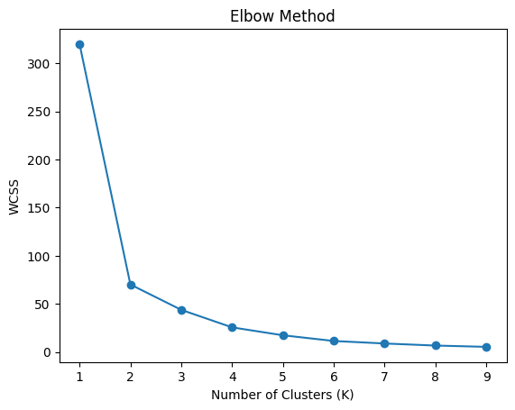
Lower WCSS = better clustering When clusters increase, WCSS always decreases Large drop:- k=1 → k=2 → k=3 Small drop:- k=4 onwards Cluster 1 Younger people No heart disease Low risk Cluster 2 Middle-aged patients Some heart disease cases Moderate risk Cluster 3 Older patients High heart disease probability High risk group The WCSS values decrease rapidly until k=3 and then decrease slowly This indicates the optimal No.of clusters =3

Slide 2
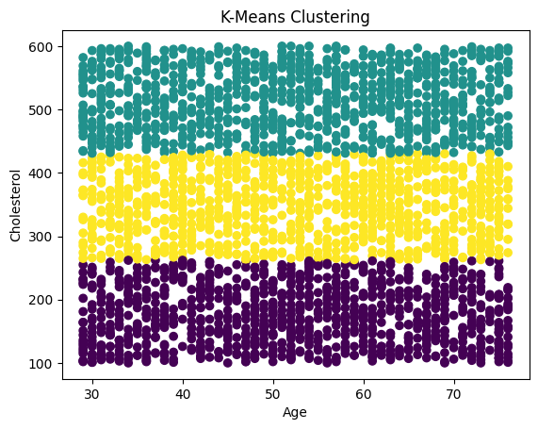
X-axis → Age Y-axis →cholesterol Each dot = one patient colors represents No.of clusters Cluster 0(purple):- Age 30 – 75 cholesterol 100 – 250 Cluster 1(Yellow):- cholesterol 260 – 420 Cluster 2(Green):- cholesterol 430 – 600 Cluster Meaning Cluster 0 Low risk patient Cluster 1 medium risk Cluster 2 High risk Low risk:- Health cholesterol Regular monitoring needed medium risk:- lifetime changes recommended High risk:- Immediate medical attention

